Slide 1

POE POWERPOINT PRESENTATION FOR CYBERSECURITY AWARENESS CHATBOT

Slide 2
INTRODUCTION OF THE PROJECT
South Africa has seen an increase in cyberattacks, which are increasingly targeting individuals, businesses, and governmental bodies (Pieterse, 2021). In response to these ever-growing threats, the Department of Cybersecurity has set in motion a campaign to help educate South African citizens in identifying and easing these cyber threats. We have been tasked to develop a cybersecurity awareness chatbot, which will interact with users and educate them on cybersecurity topics and help them avoid common traps.

Slide 3

WHAT IS CYBERSECURITY?
According to IBM (2024), cybersecurity refers to technologies, practices and policies for protecting computer systems, networks, devices, programs, data, financial assets and people from cyber threats.

Slide 4
PURPOSE OF THE CHATBOT PROJECT
The purpose of this chatbot is to educate users by providing basic cybersecurity knowledge, such as recognizing phishing emails, setting up strong passwords and avoiding online scams. It also allows users to ask any question related to cybersecurity and gives them answers on the best practices for staying safe online.

Slide 5
EXPLAINING THE CODE:
This chatbot project is designed as a console application that will serve as a Cybersecurity Awareness Assistant Bot. The chatbot will cover topics like phishing, phishing emails, safe password practices, safe browsing, ransomware, insider threats, cryptojacking, and many more cyber threats. The user will interact with the chatbot by asking the chatbot questions about cybersecurity topics
The project I have created consists of 5 classes, including the main method. The class names are:
1. Program Class- This is the main class and it is where the instance classes for Display Logo, Voice Greeting and ChatBot Interaction are created.
2. Display Logo Class- This class allows the ASCII art logo to be displayed right before the actual program begins to show the users that this AI chatbot is about cybersecurity.
3. Voice Greeting Class- This class allows the welcome message of the chatbot to play as the user begins the program.
4. Response Handler Class- This class handles the responses by firstly loading the responses on a text file and finding the best response for the user, allowing for an excellent user experience.
5. Chatbot Interaction Class- This class is responsible for managing how users can interact with the chatbot.

Slide 6
CLASS 1: MAIN CLASS (PROGRAM CLASS)
The Program class will be my main class. This is where I create instance classes for three of the five classes (Display Logo, Voice Greeting and ChatBot Interaction classes) that I have in my project. I created the VoiceGreeting instance class to allow the voice greeting message to be played. I created the DisplayLogo instance class to allow my chosen logo to be displayed using ASCII art, and lastly, I created the ChatBotInteraction instance class to handle the interactions between the user and the chatbot. The purpose of this class is to allow the three classes to be able to run.

Slide 7
CLASS 2: DISPLAY LOGO CLASS
The Display Logo class allows the correct ASCII art logo to be displayed on the user interface before the program begins. This is to show the user that this AI chatbot is only about cybersecurity. Inside the class, a constructor was automatically invoked due to an instance class being created in the main class. However, before beginning with the ASCII logo, I got the full path of the picture I will be using to create the logo and replaced that path with this: bin\\Debug, and then I got the newly updated path of the picture (this is where the constructor ends).
For the actual logo, I created a method that will give the size of the logo. I used an inner and outer nested for loop to create the height and the width of the logo and the colour of the logo. The outer loop was for creating the height, and the inner loop was for creating the width of the logo. For the ASCII design, I used different characters such as ".", "*", "O", "#" and "@".

Slide 8
CLASS 3: VOICE GREETING CLASS
The Voice Greeting class allows the voice welcome message of the chatbot to play as the user interacts with the program. I converted a text-based greeting into a spoken message using an AI website to make it sound more professional, and then I converted the MP3 format to a WAV format for compatibility with System.Media in C#. Inside the class, a constructor was automatically invoked due to an instance class being created in the main class. However, just like in the Display Logo class, before playing the actual WAV sound, I got the full path of the sound I will be using to play the welcome message and replaced the path with this: bin\\Debug, and then I got the newly updated path of the sound (this is where the constructor ends).
For the sound to play, I created a method that will play the .WAV sound file. I used a try-catch to handle an error message for when the sound does not play, but when the sound plays till the end, no error message will be displayed.

Slide 9
CLASS 4: RESPONSE HANDLER CLASS
The Response Handler class handles the responses by firstly loading the responses on a text file I named Predefined_Responses.txt, and from this text file it finds the best response for the user to allow for an excellent user experience. Inside this class, a global variable called response handler was created and declared to store the predefined responses from the file. A constructor was thereafter created to assign the created variable to a method that will load these predefined responses.
After the constructor, I created a private method called LoadPredefinedResponses that will load the predefined responses from the text file, and inside this method, I first created an ArrayList to store these responses and proceeded to use a foreach loop to load all the responses to an array.
At the end of this method, I created a public method this time to allow it to be used in other classes (in this instance, the ChatBotInteraction Class). This method compares user input and gets the best response from the text file. I used a foreach loop for the program to look through the ArrayList for user input and give the corresponding response. If a response is not found for what the user has entered, an error message will be displayed, and it will proceed to ask the user if they would like to rephrase what they had said.

Slide 10
CLASS 5: CHATBOT INTERACTION CLASS
The ChatBot Interaction class is responsible for managing user interactions with the chatbot, processing user text inputs and determining the appropriate replies based on the user's input. Within the class, a global variable named response handler was created and declared to access the response handler class and to retrieve predefined responses from the text file Predefined_Responses.txt. The response handler variable was thereafter assigned to a constructor that I created in order for all the methods in the response handler class could also be accessed in this class. A method called BeginChat was also called inside this constructor and the purpose of this method is to allow the interaction between the chatbot and the user to begin.
Inside the BeginChat method, two string variables were declared: the username ("You") and the chatbot's name ("CyberBot"), and thereafter, a welcome message and the purpose of the chatbot are displayed. The welcome message and purpose are: Welcome to the South African Awareness ChatBot! Here to help you spot phishing emails, craft uncrackable passwords and browse the web like a pro. The colour used to display the welcome message and purpose is dark cyan, and for the user it is dark magenta and for the chatbot it is dark grey. Immediately after the welcome message, the chatbot tells the user its name and asks them for their name and the user should enter their name in a string. Should the user enter characters or not enter anything at all, an error message will be displayed, and to handle this error, I declared a string variable to store a regex, then I created a while loop.
The chatbot proceeds to ask the user how they are feeling on that particular day, therefore, I used an if-else-statement to display an appropriate message based on how the user is feeling. For example, if the user isn't feeling good, the chatbot will respond with a "I'm sorry to hear that" text and if the user is feeling good, the chatbot will respond with a "I'm glad to hear that" message. After asking the user how they are feeling, the chatbot proceeds to ask the user how they may be of assistance to them, and for this I used a while loop in order for the chat to continue until the user ends the program. If the user does end the program, they need to type "exit" and the program will automatically stop (I used an if-statement for this section).

Slide 11
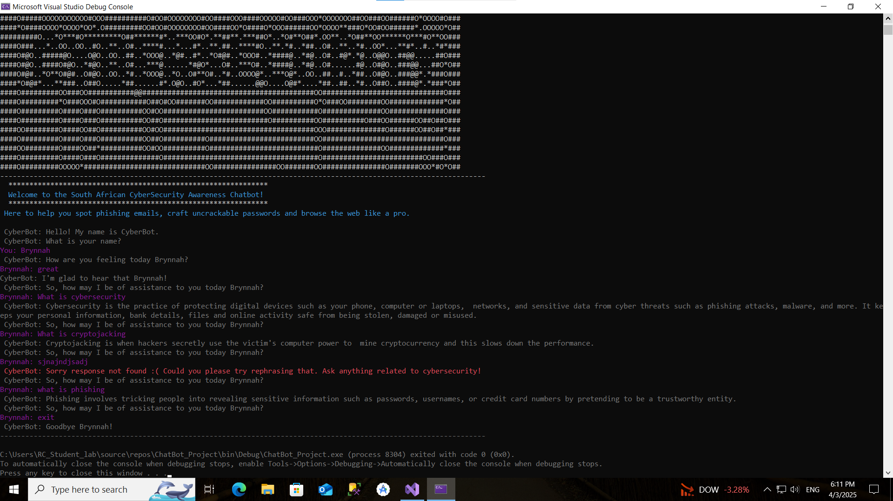
EXAMPLE OF CHATBOT INTERACTION

Slide 12
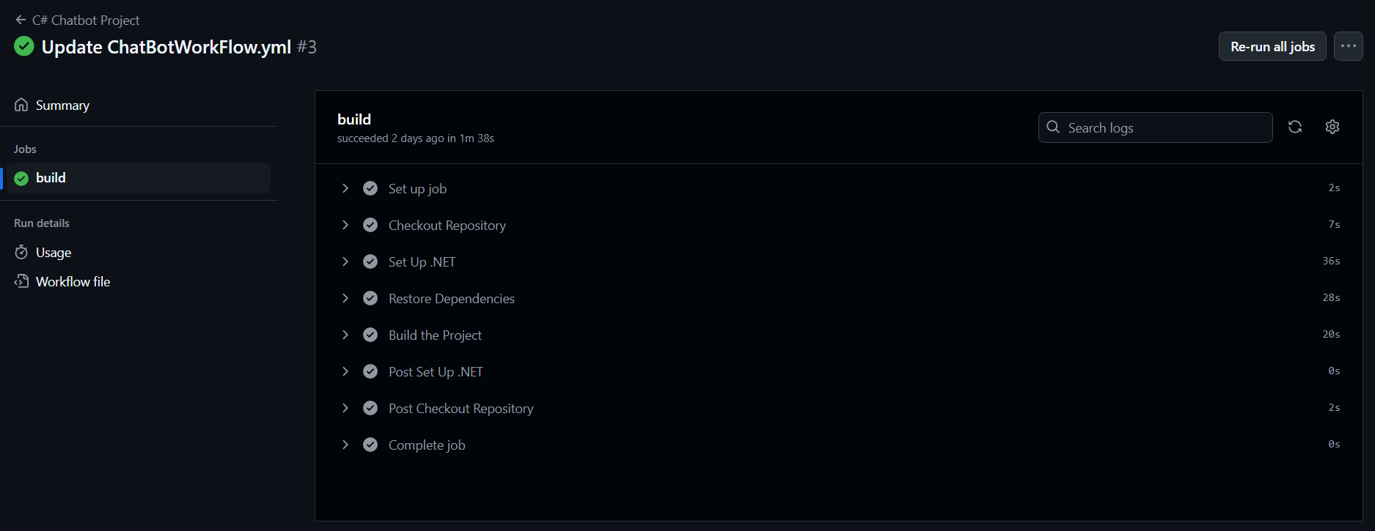
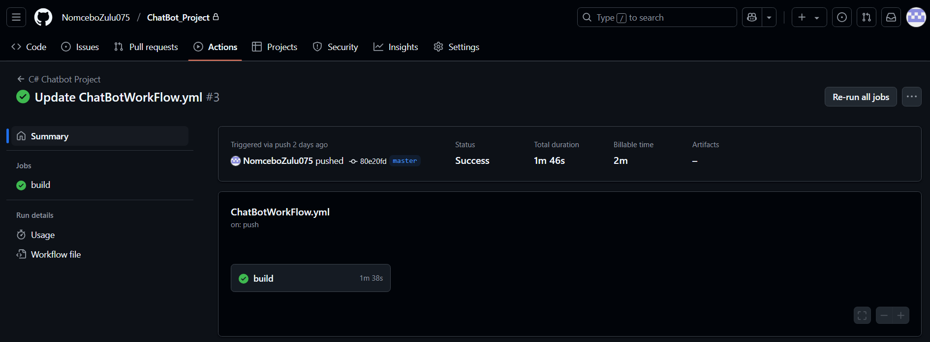
SCREENSHOTS OF CI WORKFLOW – SCREENSHOT 1
The CI Workflow Build

Slide 13
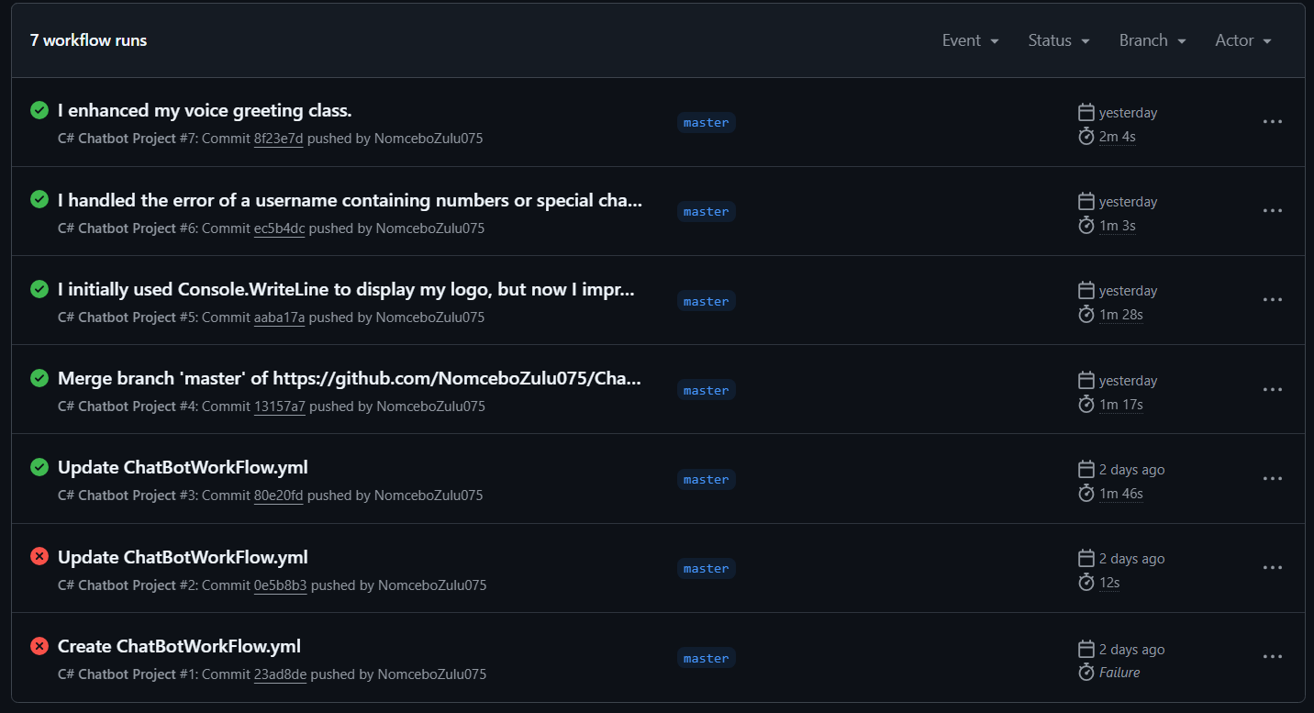
SCREENSHOTS OF CI WORKFLOW – SCREENSHOT 2
I did three workflow runs. For the first two, I got them wrong due to syntax errors, and the third time, I got the green checkmark, indicating that my workflow ran successfully!

